Slide 1
GCIMS Tools & Integration
Zarrar Khan, Chris Vernon,
Mengqi Zhao, Taryn Waite,
Isaac Thompson

Slide 2

New Staff – Ben Knight
Foresight Team
Undergraduate at UMD
Majoring in Computer Science
Minor in Computational Finance & Music Performance for Double Bass
Enjoys:
Traveling around the world (recently visited Iceland)
Scuba Trips down to Florida

Slide 3






GCIMS Integration Roadmap
Software
Map
Reproducible
workflows
Persistent
Insights
2. What can we do?
4. Can we do it again?
6. How to share what we did?
1. Any stranded scripts?
3. Does it work?
5. How to re-use what we did?
Packaged
Models
Software Health
Data Management
https://jgcri.github.io/gcims_integration

Slide 4
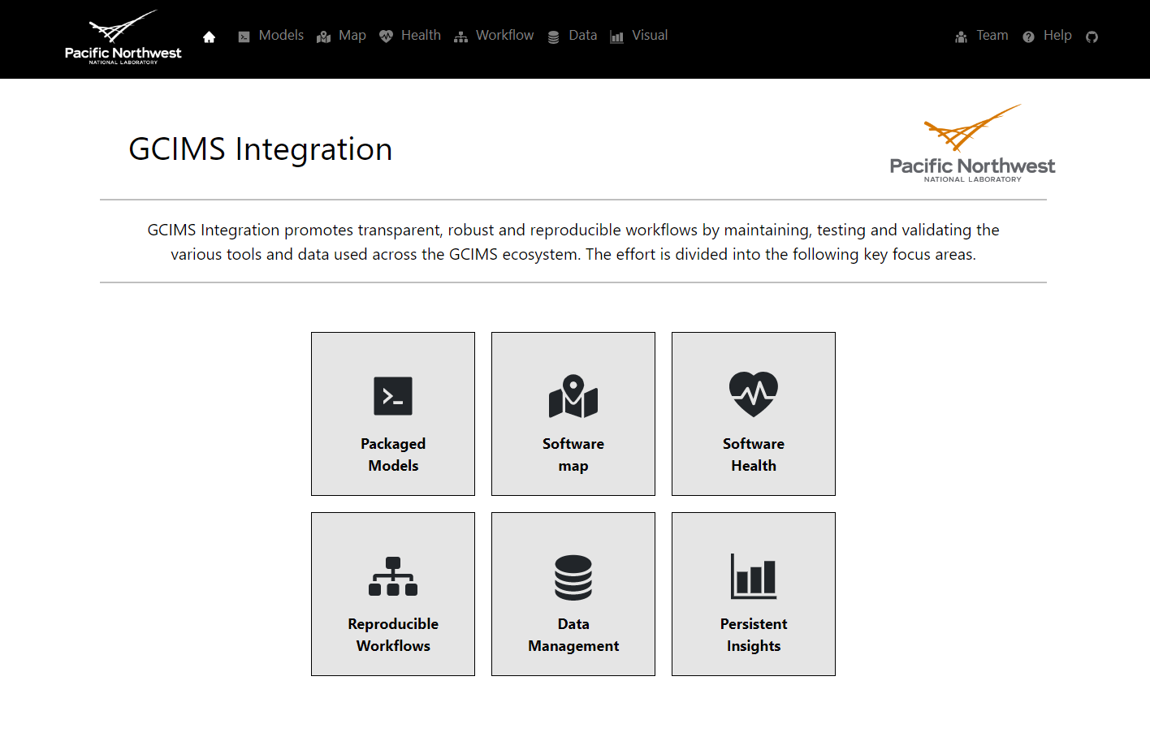
GCIMS Integration Webpage
https://jgcri.github.io/gcims_integration

Slide 5
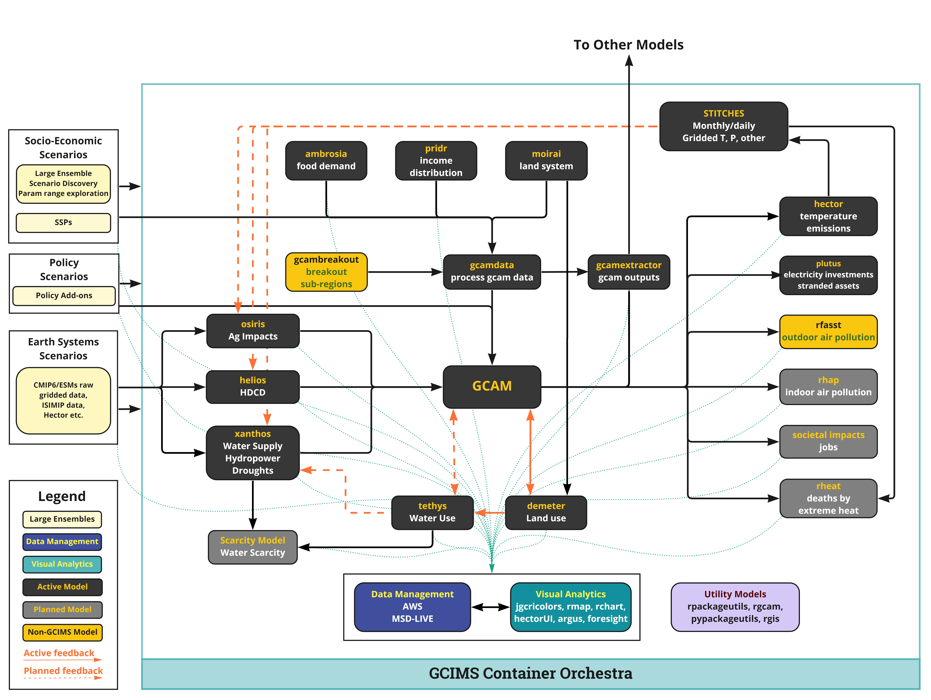
Software Map - Updates
To be Updated
CEDS
Societal Impacts (Employment package) with UMD Ryna et al.

Slide 6
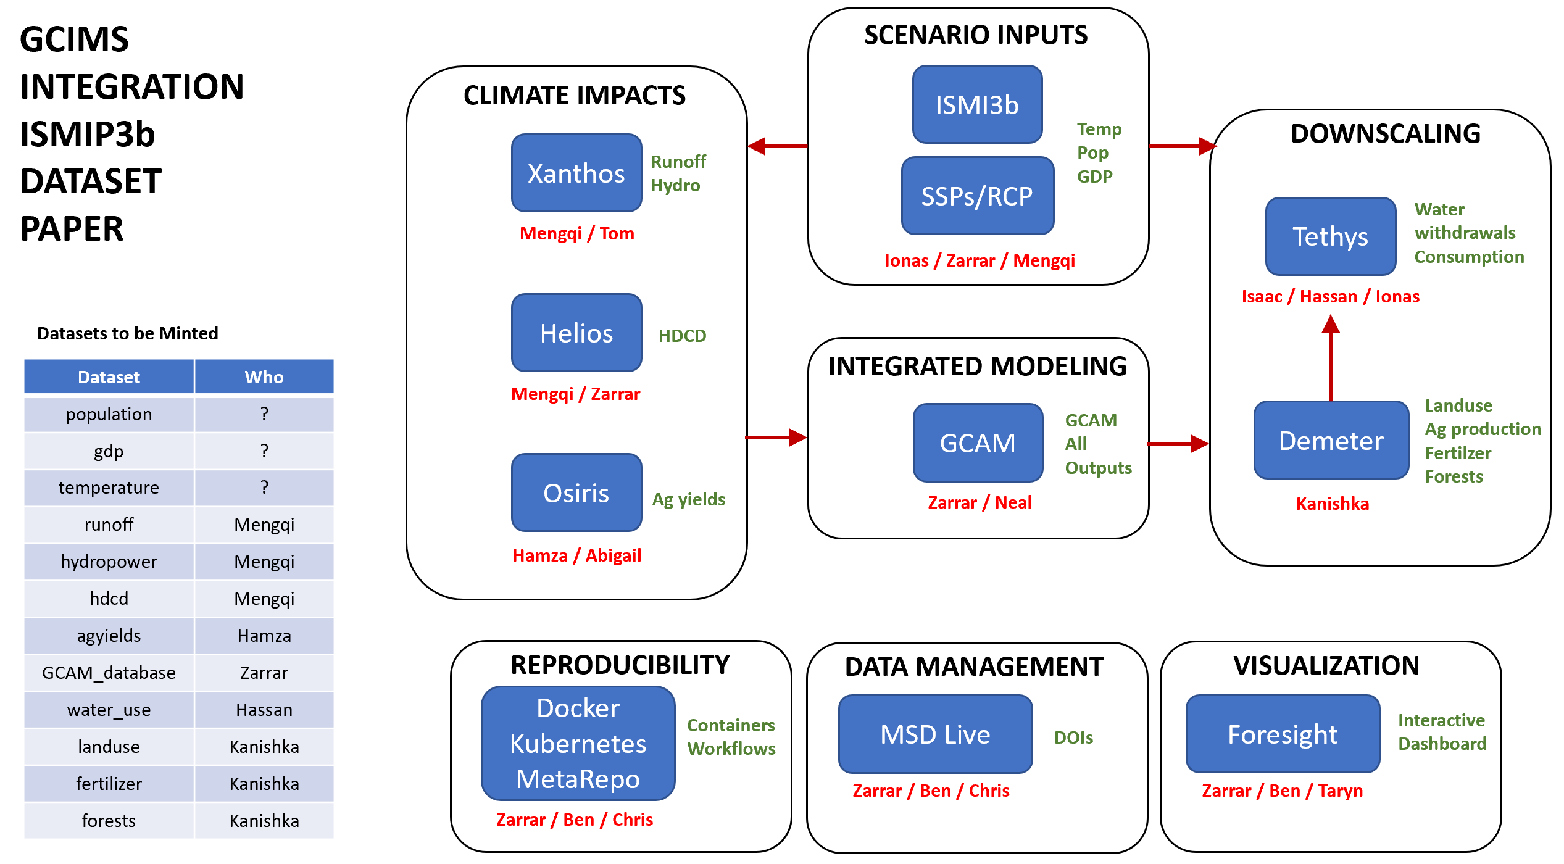
GCIMS Integration – Grand Experiment Papers

Slide 7

Foresight Updates

Slide 8
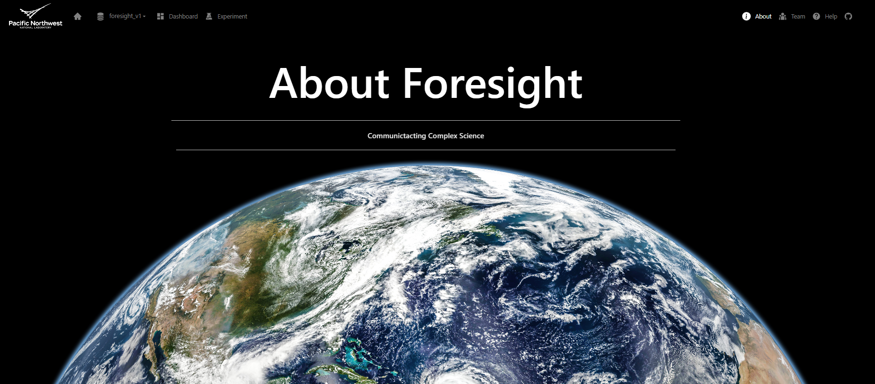
Foresight Updates – Vision!

Slide 9
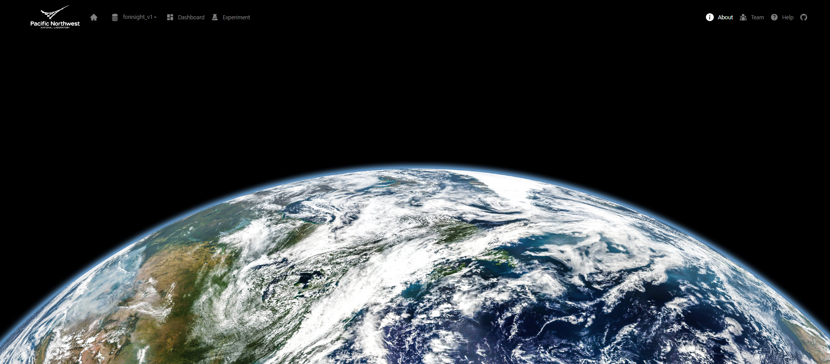
Foresight Updates – Vision!
1. Single Point of Access
3. Gold Standard of Visualization
2. Community
4. Deep Insights

Slide 10
This research was supported by the US Department of Energy, Office of Science, as part of research in MultiSector Dynamics, Earth and Environmental System Modeling Program.

Slide 11














GCIMS Integration: Managing GCIMS tools for Robust, Resilient, Scalable Research
Data
Scripts
Scripts
Publications
1
Issue | Solution
5
Stranded Scripts
1
Packaged models
Outputs
Outputs
Stranded Knowledge
2
Software Map
GCAM
v Y.0
GCAM
v X.1
4
Software Health
CI/CD
Stranded Model Versions
3
Analysis
Analysis
Reproducible
Workflows
6
Stranded Analysis
4
3
Data Management
Minting DOIs
Insights
Stranded Datasets
5
Models
Insights
Models
Dashboard
Persistent Insights
2
Stranded Insights
6
Teams
Teams

Slide 12
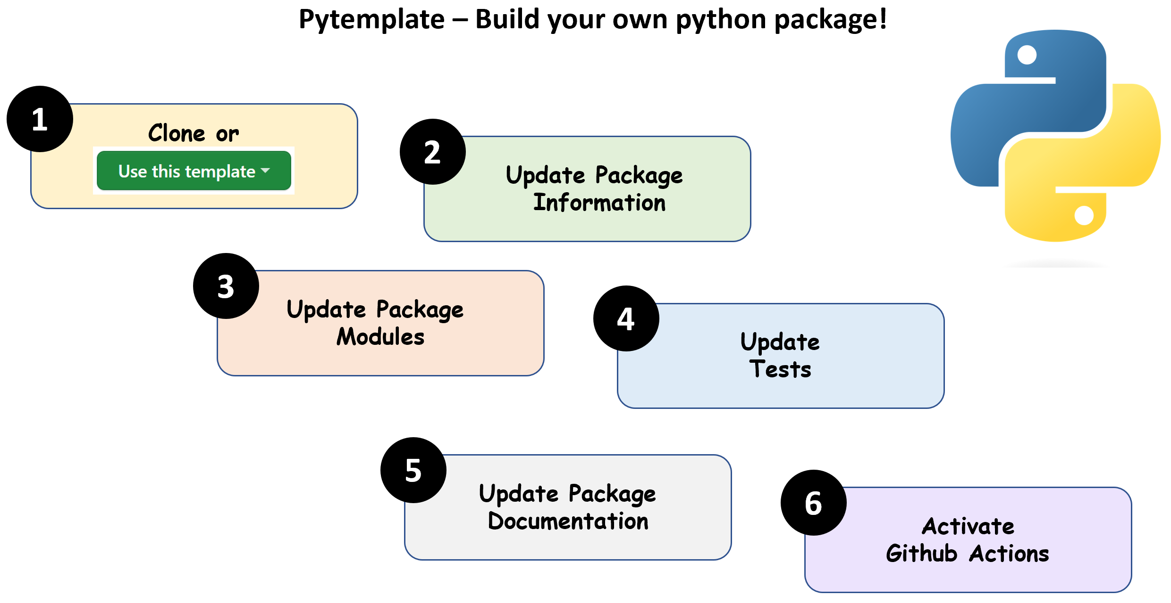
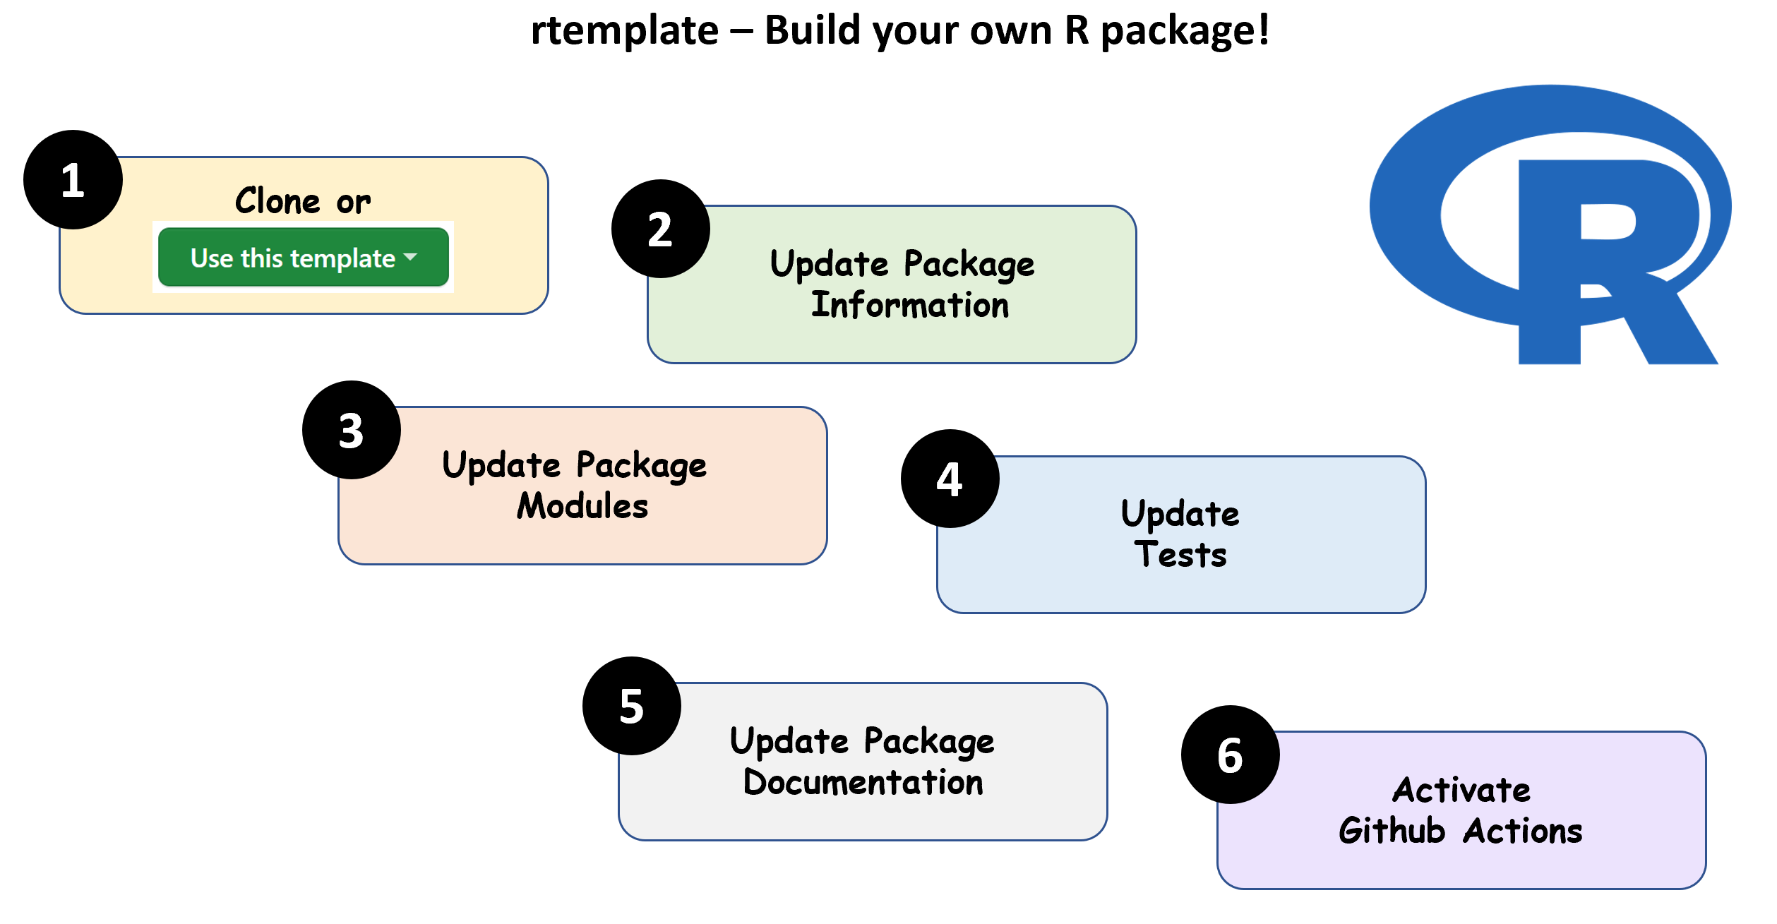
1. Packaged Models: Any Stranded Scripts?
Clear Templates for R & Python Packages
https://jgcri.github.io/gcims_integration/#/models
Individual Package Design
Folder Structure
Continuous Integration
Multi OS Build Checks
Code Testing
Documentation

Slide 13
2. Software Map: What can we do?
Software Map
https://jgcri.github.io/gcims_integration/#/map
Track down and Map out
Data sources
Existing models
Planned models
Inter-linkages

Slide 14
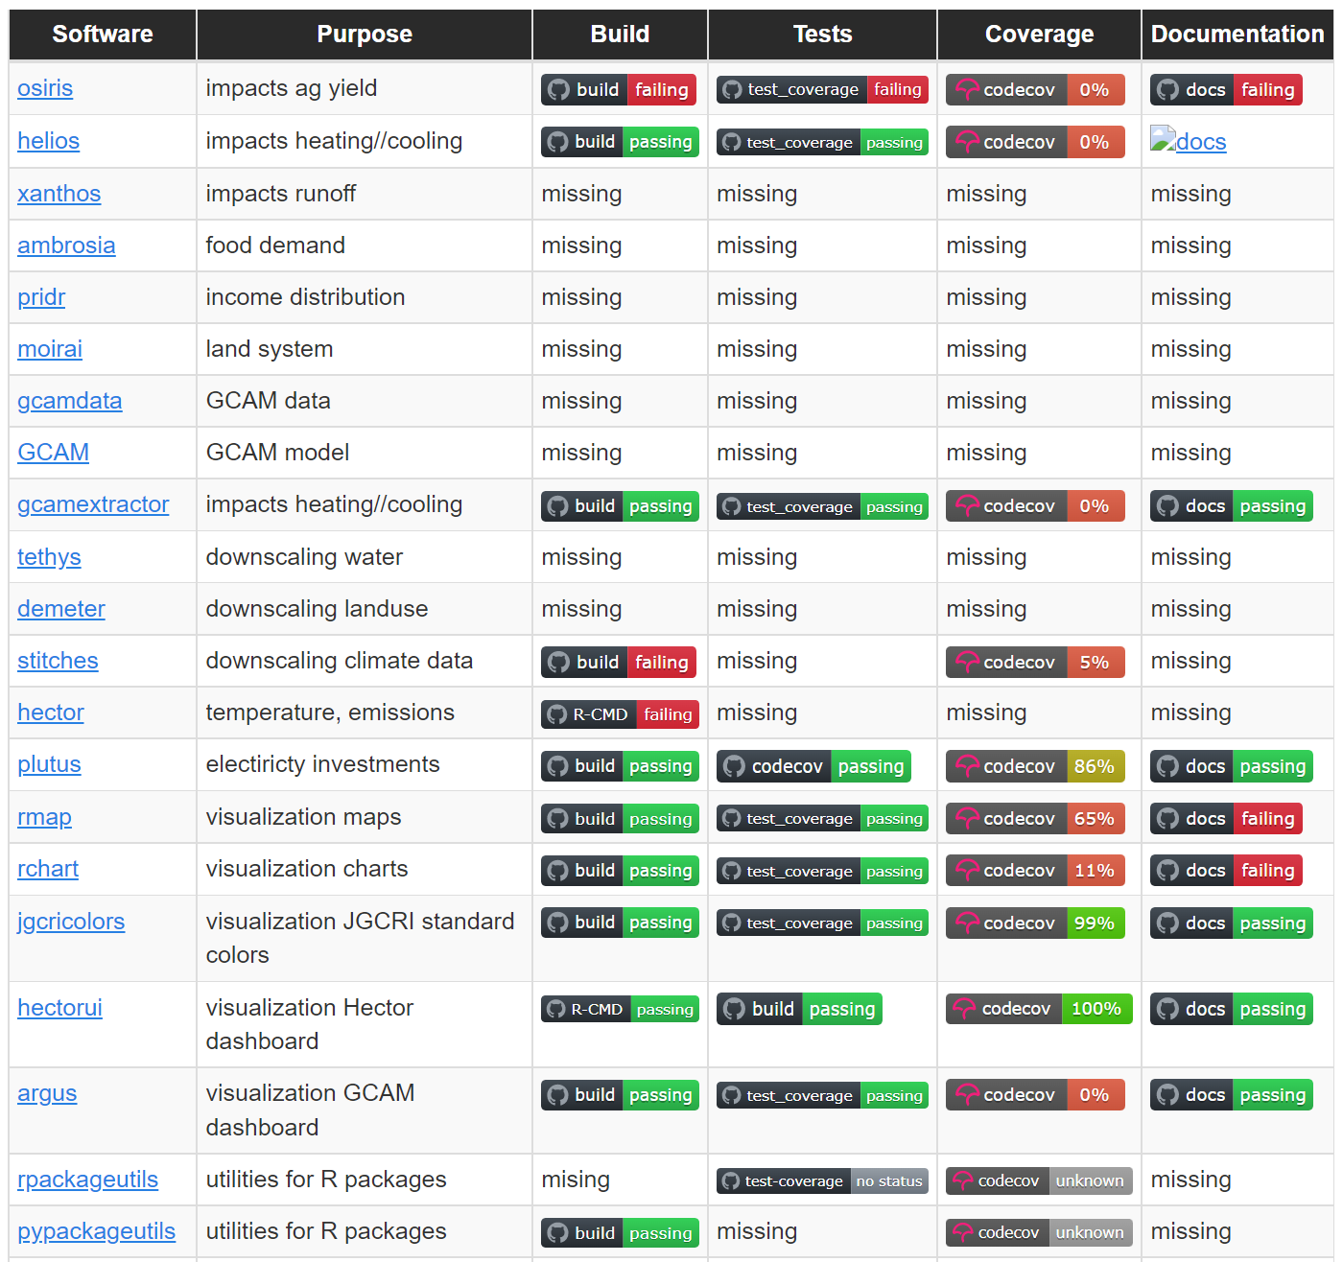
3. Software Health: Does it work?
Overall System Health Monitoring
https://jgcri.github.io/gcims_integration/#/health
Overall System Monitoring
Continuous Integration
Multi OS Build Checks
Code Testing
Code Coverage
Documentation

Slide 15
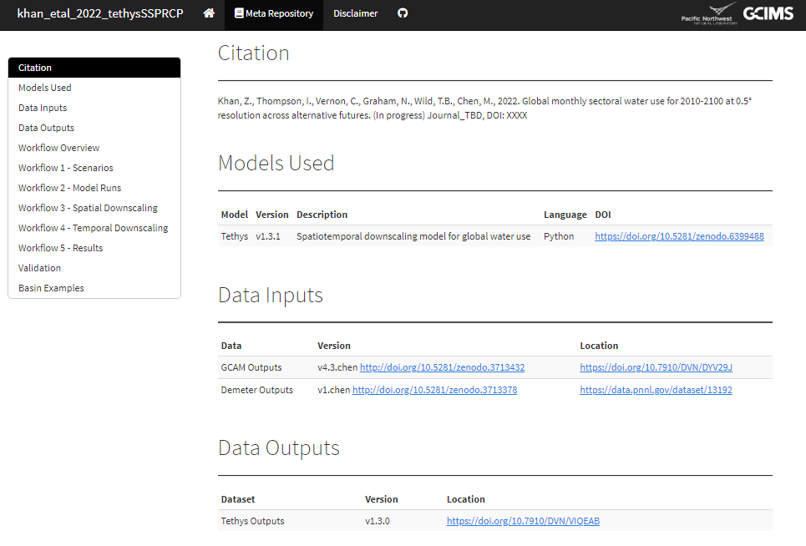
4. Reproducible Workflows: Can we do it again?
Reproducible Workflows
https://jgcri.github.io/gcims_integration/#/workflow
https://jgcri.github.io/khan-etal_2022_tethysSSPRCP/metarepo.html
Reproducible workflows
Meta-repo templates
Inputs with DOI
Outputs with DOI
Workflows
Validation
Results
Containerization
Scalable
Cloud/On-prem/hybrid

Slide 16
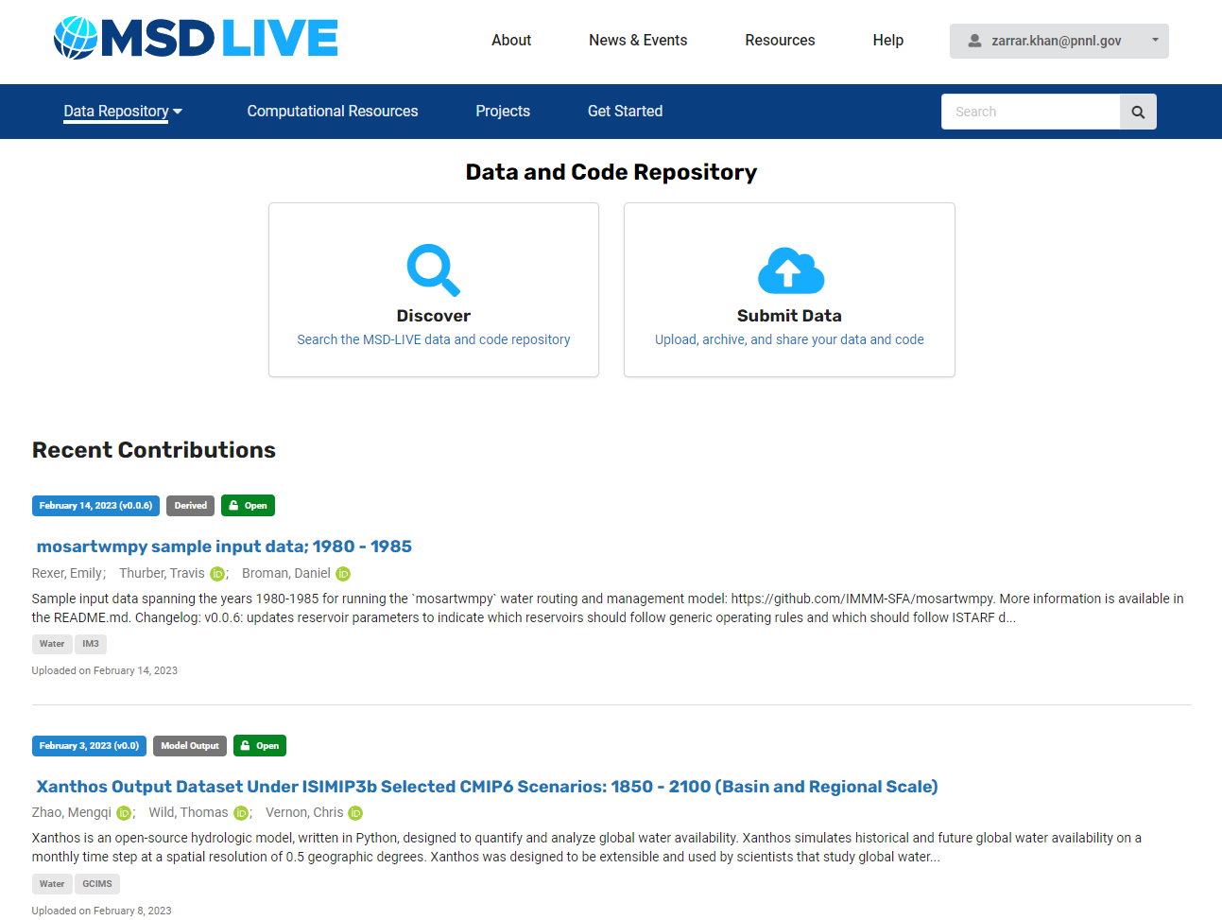
5. Data Management: Re-use what we did
Persistent Data Management
https://data.msdlive.org/
Persistent Data Management
FAIR
Findability
Accessibility
Interoperability
Reusability
Key Features
Minted with DOIs
Meta-data
Storage (MSD, Deception, Cloud)

Slide 17
6. Persistent Insights: Share what we did

